Slide 1


Network Measures
SOCIAL
MEDIA
MINING

Slide 2
Dear instructors/users of these slides: Please feel free to include these slides in your own material, or modify them as you see fit. If you decide to incorporate these slides into your presentations, please include the following note:
R. Zafarani, M. A. Abbasi, and H. Liu, Social Media Mining: An Introduction, Cambridge University Press, 2014.
Free book and slides at http://socialmediamining.info/
or include a link to the website: http://socialmediamining.info/

Slide 3
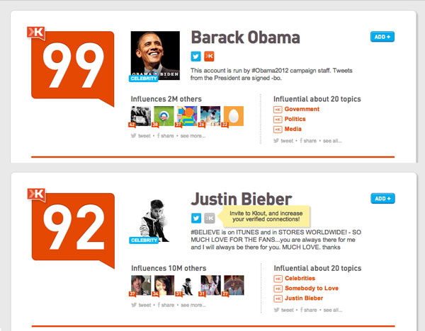
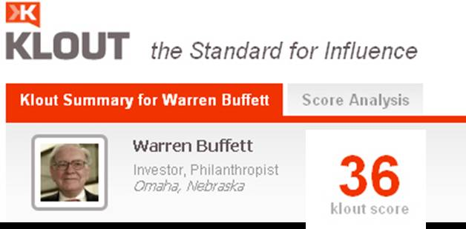
Klout
It is difficult to measure influence!

Slide 4
Why Do We Need Measures?
Who are the central figures (influential individuals) in the network?
Centrality
What interaction patterns are common in friends?
Reciprocity and Transitivity
Balance and Status
Who are the like-minded users and how can we find these similar individuals?
Similarity
To answer these and similar questions, one first needs to define measures for quantifying centrality, level of interactions, and similarity, among others.

Slide 5
Centrality
Centrality defines how important a node is within a network

Slide 6
Centrality in terms of those who you are connected to

Slide 7
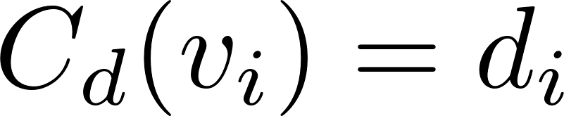
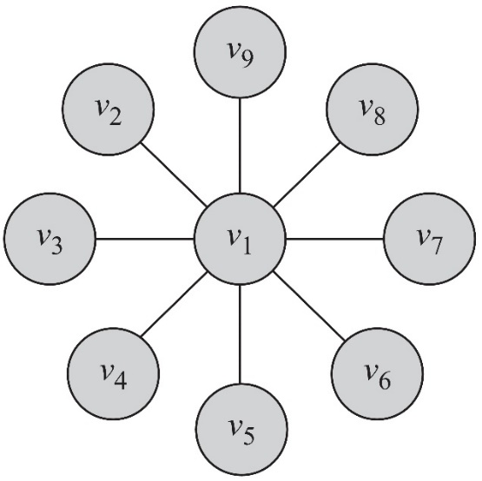
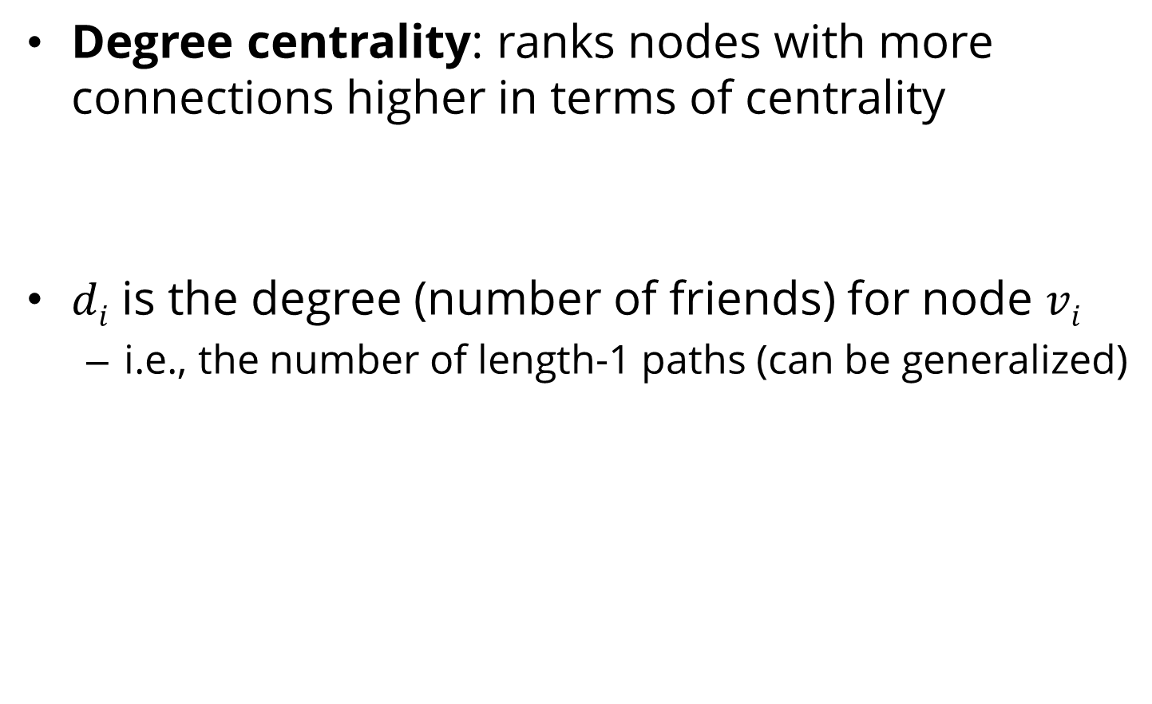
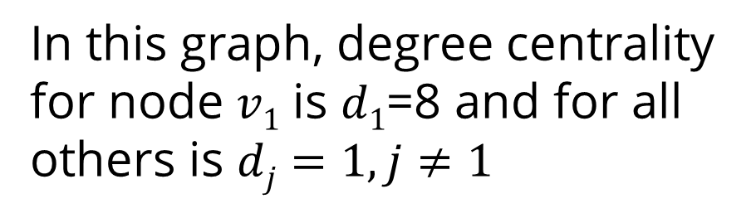
Degree Centrality
Degree centrality: ranks nodes with more connections higher in terms of centrality
$di$ is the degree (number of friends) for node $vi$
i.e., the number of length-1 paths (can be generalized)
In this graph, degree centrality for node $v1$ is $d1$=8 and for all others is $dj=1, j≠1$

Slide 8
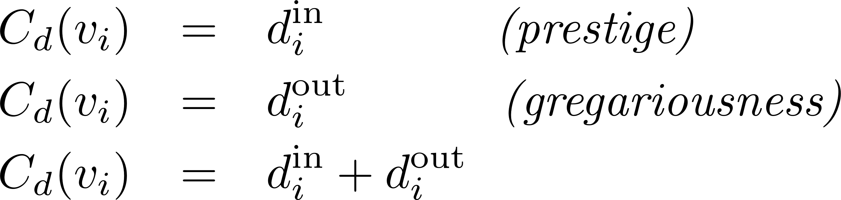
Degree Centrality in Directed Graphs
In directed graphs, we can either use the in-degree, the out-degree, or the combination as the degree centrality value:
In practice, mostly in-degree is used.
$d_{i}^{out}$ is the number of outgoing links for n$ode vi$

Slide 9
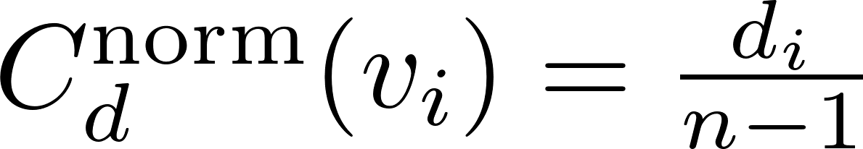
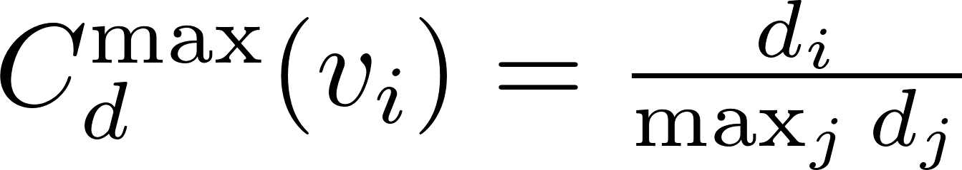
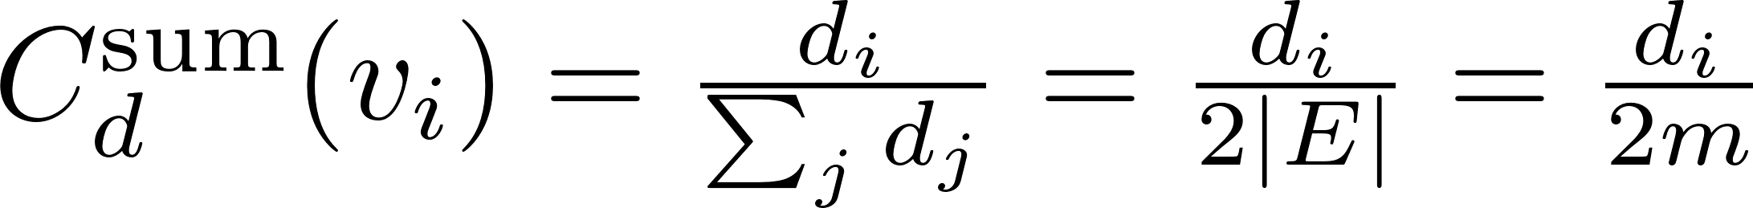
Normalized Degree Centrality
Normalized by the maximum possible degree
Normalized by the maximum degree
Normalized by the degree sum
Notes:
n – 1 is the maximum degree a node can have
2|E| = the total number of degrees,

Slide 10
Degree Centrality (Directed Graph)Example
Node | In-Degree | Out-Degree | Centrality | Rank
A | 1 | 3 | 1/2 | 1
B | 1 | 2 | 1/3 | 3
C | 2 | 3 | 1/2 | 1
D | 3 | 1 | 1/6 | 5
E | 2 | 1 | 1/6 | 5
F | 2 | 2 | 1/3 | 3
G | 2 | 1 | 1/6 | 5
Normalized by the maximum possible degree
Notes:
Out-degree is used

Slide 11
Degree Centrality (undirected Graph) Example
Node | Degree | Centrality | Rank
A | 4 | 2/3 | 2
B | 3 | 1/2 | 5
C | 5 | 5/6 | 1
D | 4 | 2/3 | 2
E | 3 | 1/2 | 5
F | 4 | 2/3 | 2
G | 3 | 1/2 | 5

Slide 12

Eigenvector Centrality
Having more friends does not by itself guarantee that someone is more important
Having more important friends provides a stronger signal
Phillip Bonacich
Eigenvector centrality generalizes degree centrality by incorporating the importance of the neighbors (undirected)
For directed graphs, we can use incoming or outgoing edges

Slide 13
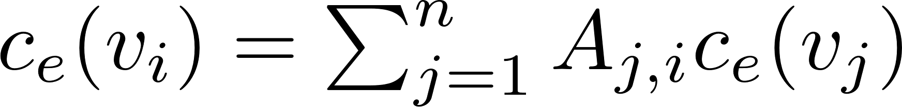
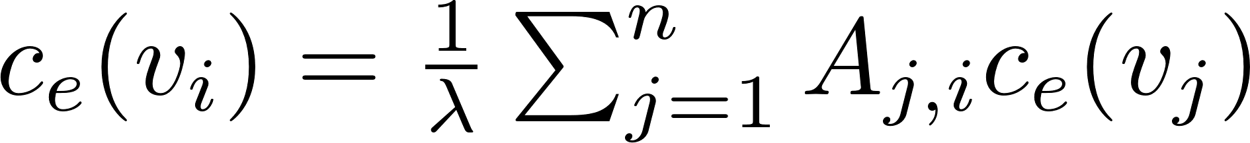
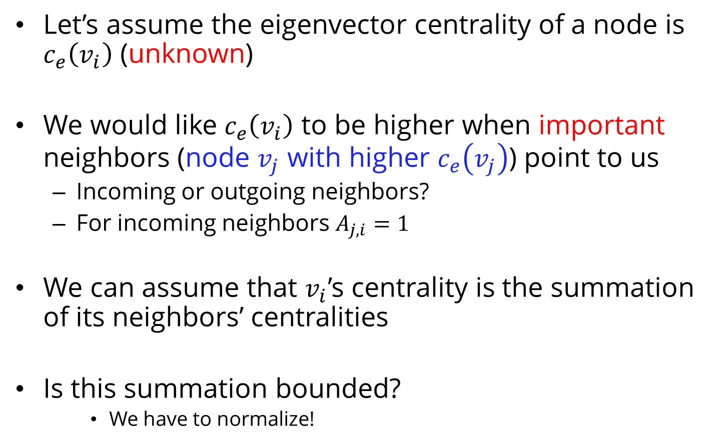
Formulation
Let’s assume the eigenvector centrality of a node is $c_{e}\left(v_{i}\right)$ (unknown)
We would like $c_{e}\left(v_{i}\right)$ to be higher when important neighbors (node $v_{j}$ with higher $c_{e}\left(v_{j}\right)$) point to us
Incoming or outgoing neighbors?
For incoming neighbors $A_{j,i}=1$
We can assume that $v_{i}$’s centrality is the summation of its neighbors’ centralities
Is this summation bounded?
We have to normalize!
λ: some fixed constant

Slide 14
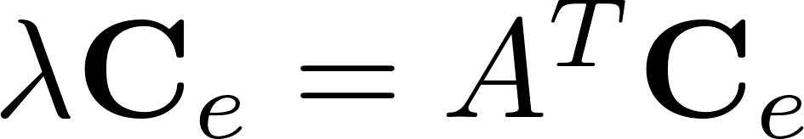
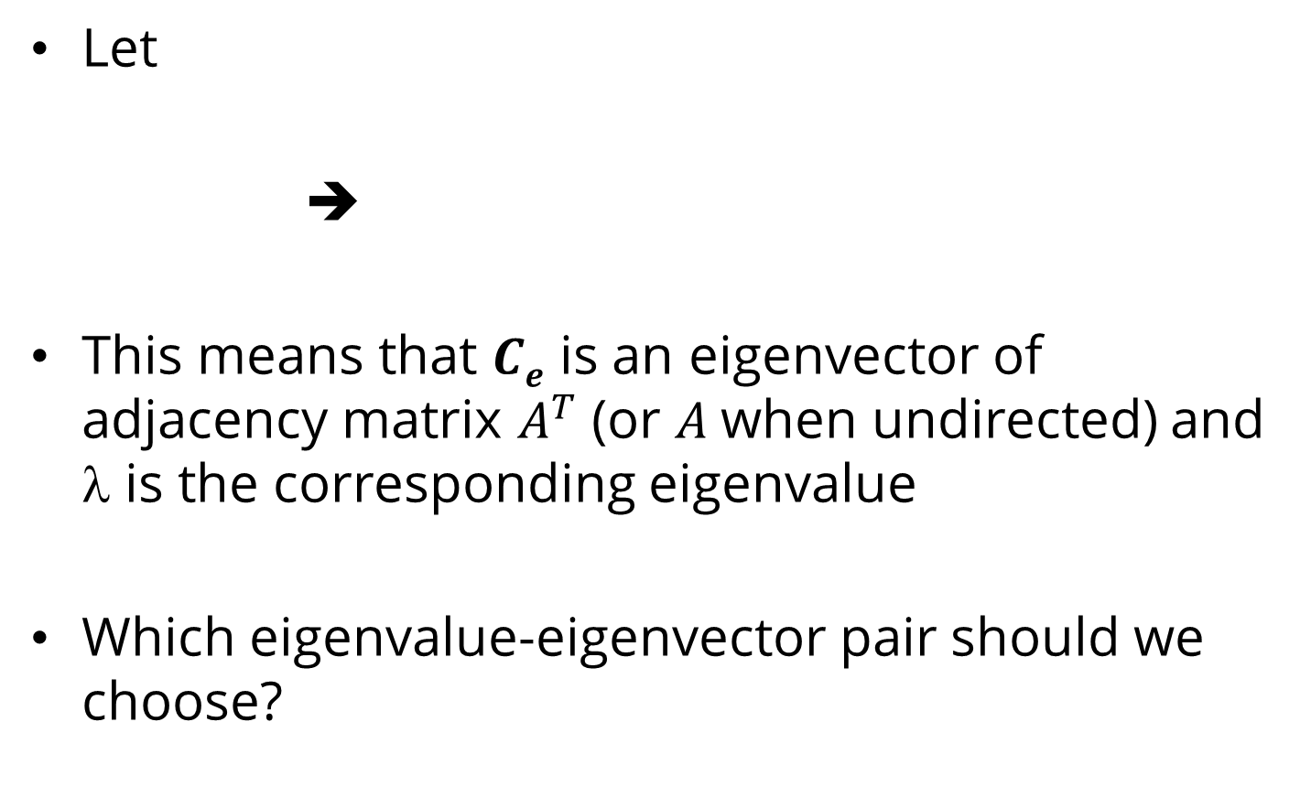
Eigenvector Centrality (Matrix Formulation)
Let
➔
This means that $Ce$ is an eigenvector of adjacency matrix $A^{T}$ (or $A$when undirected) and $$ is the corresponding eigenvalue
Which eigenvalue-eigenvector pair should we choose?

Slide 15
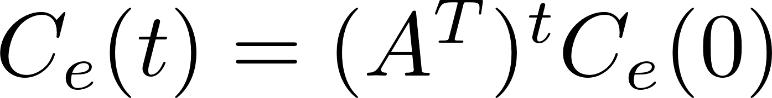
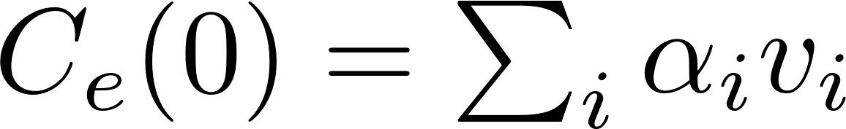
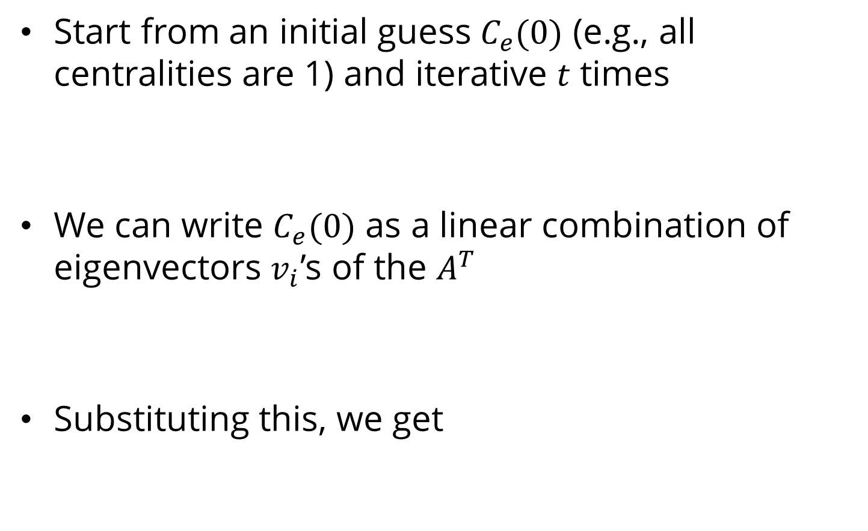
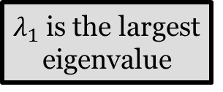
Finding the eigenvalue by finding a fixed point…
Start from an initial guess $C_{e}(0)$ (e.g., all centralities are 1) and iterative $t$ times
We can write $C_{e}(0)$ as a linear combination of eigenvectors $v_{i}$’s of the $A^{T}$
Substituting this, we get
$λ_{1}$ is the largest eigenvalue

Slide 16
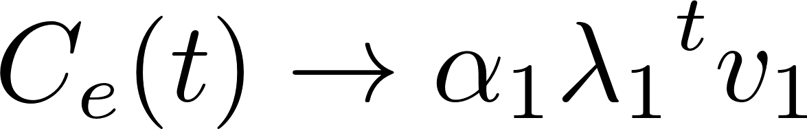
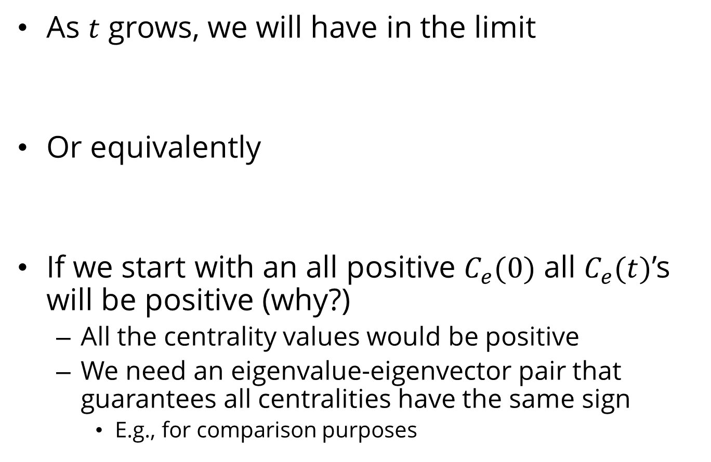
Finding the eigenvalue by finding a fixed point…
As $t$ grows, we will have in the limit
Or equivalently
If we start with an all positive $C_{e}(0)$ all $C_{e}(t)$’s will be positive (why?)
All the centrality values would be positive
We need an eigenvalue-eigenvector pair that guarantees all centralities have the same sign
E.g., for comparison purposes

Slide 17
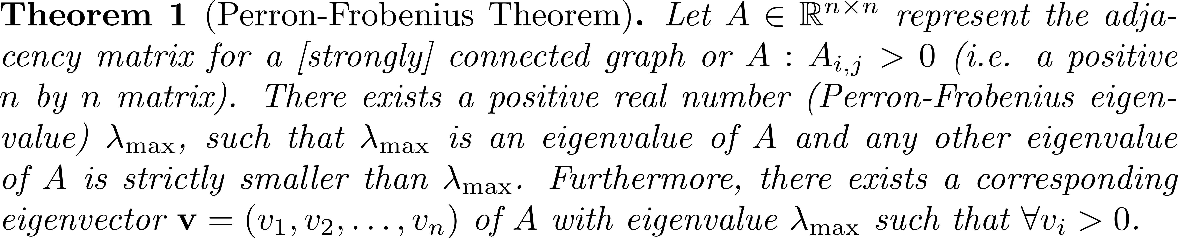
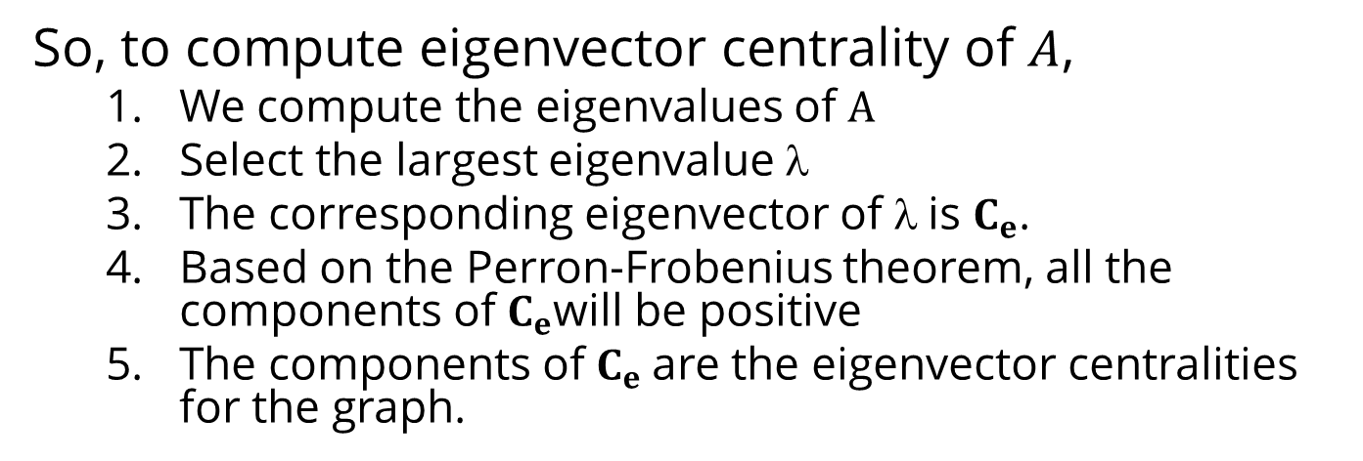
Eigenvector Centrality, cont.
So, to compute eigenvector centrality of $A$,
We compute the eigenvalues of $A$
Select the largest eigenvalue $$
The corresponding eigenvector of $$is $C_{e}$.
Based on the Perron-Frobenius theorem, all the components of $C_{e}$will be positive
The components of $C_{e}$are the eigenvector centralities for the graph.

Slide 18
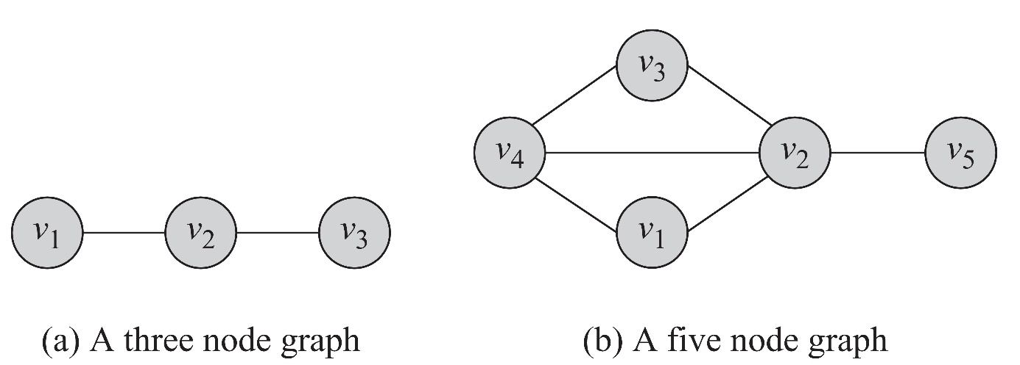
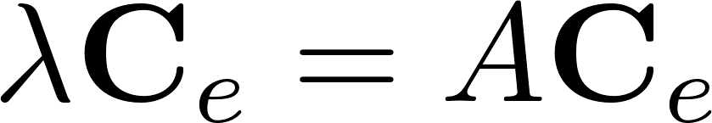
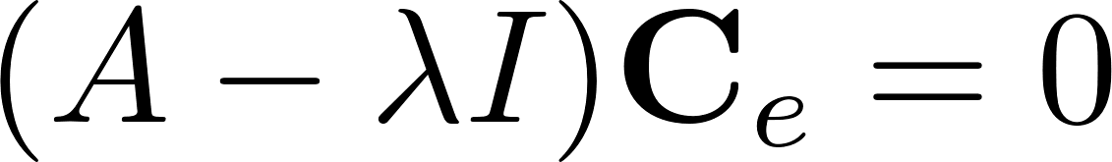
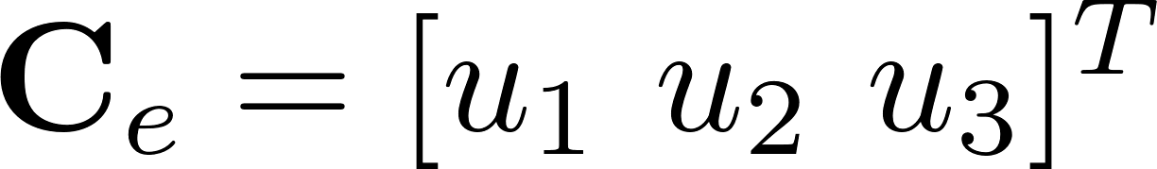
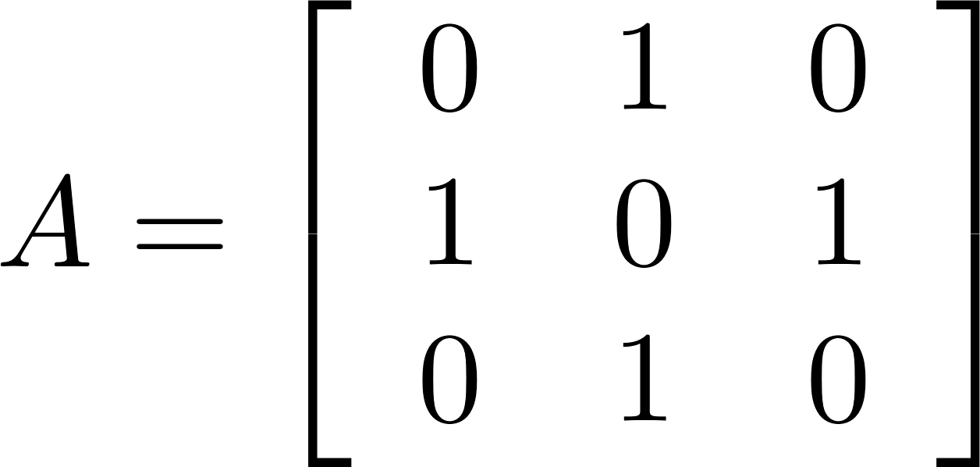
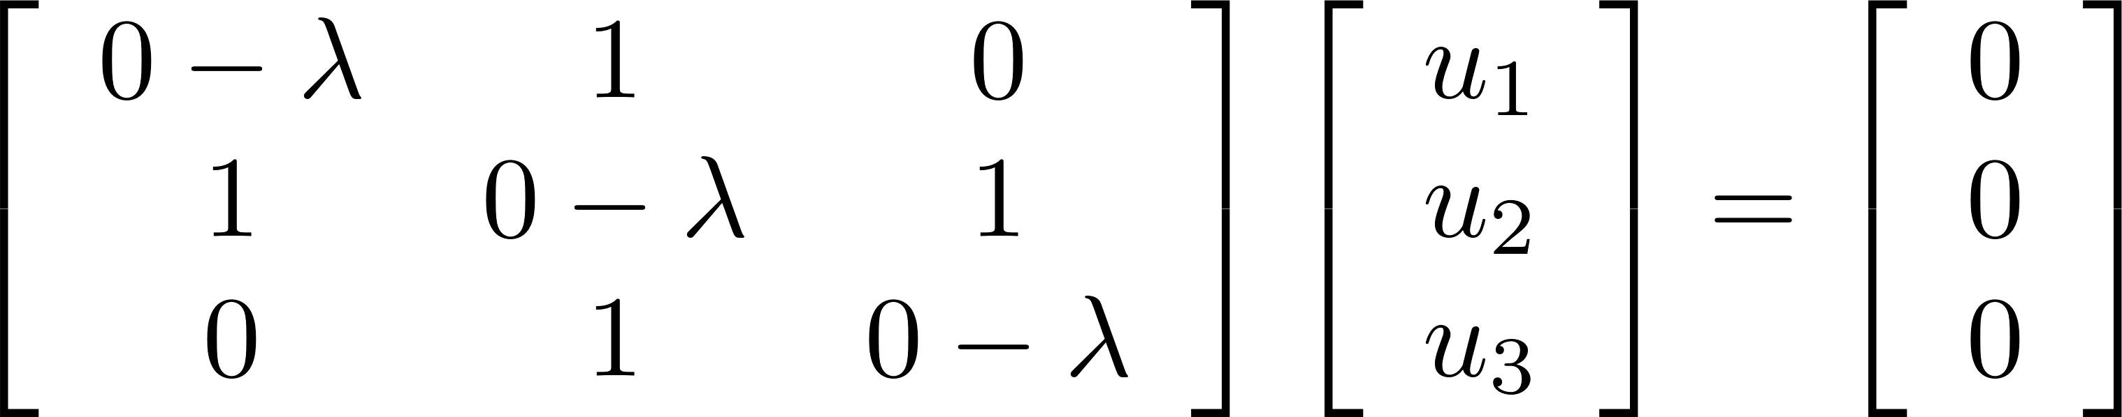
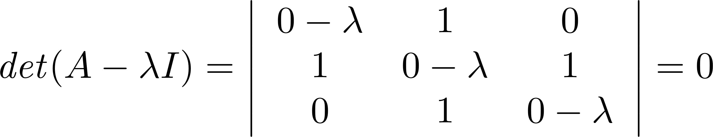
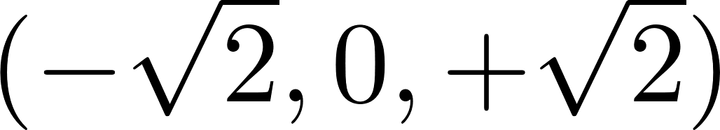
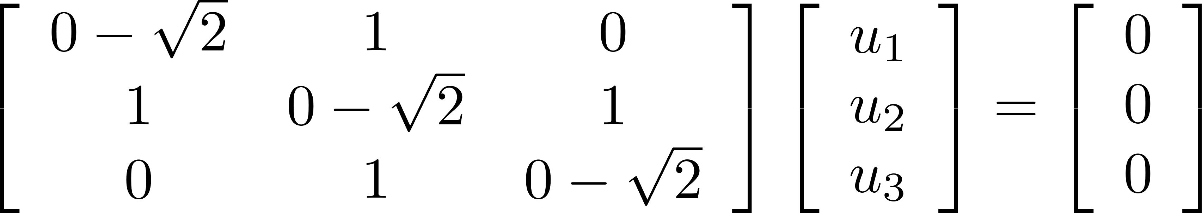
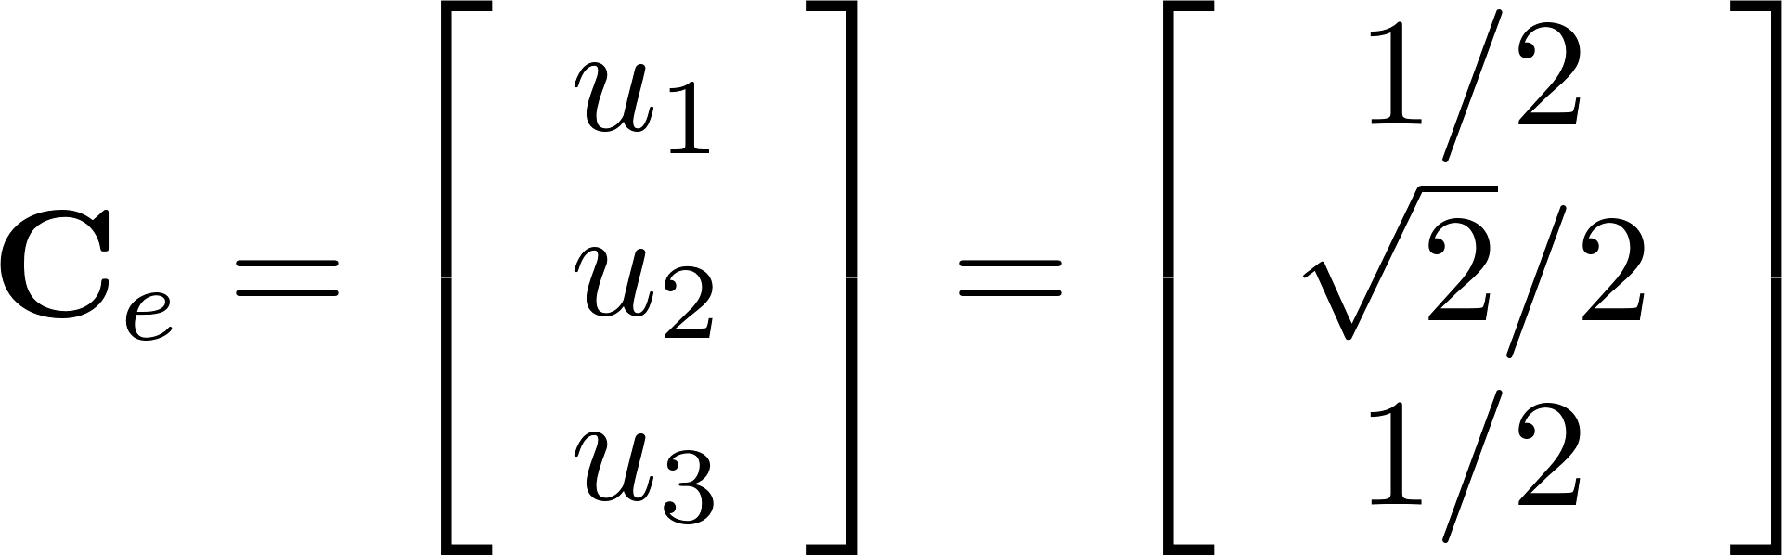
Eigenvector Centrality: Example 1
Eigenvalues are
Corresponding eigenvector (assuming $C_{e}$ has norm 1)
Largest Eigenvalue

Slide 19
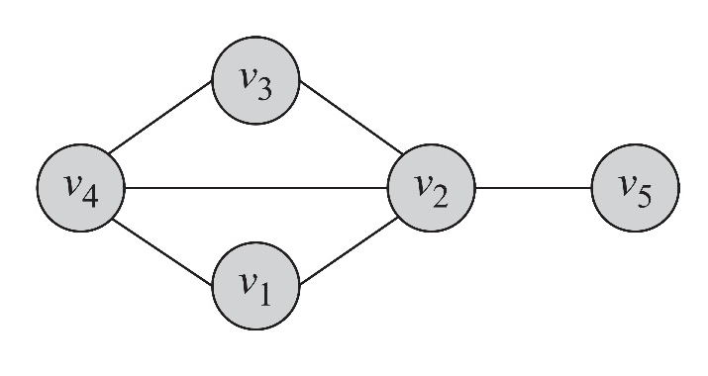
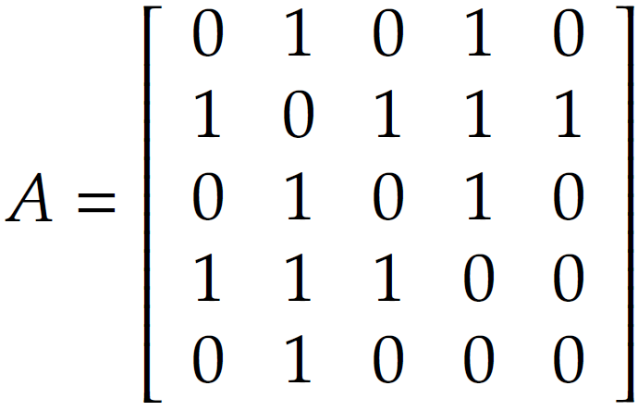
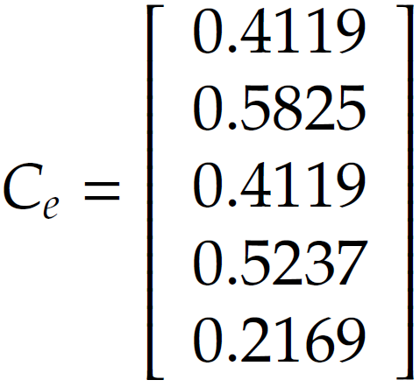
Eigenvector Centrality: Example 2
λ = (2.68, -1.74, -1.27, 0.33, 0.00)
Eigenvalues Vector
λ_{max} = 2.68

Slide 20
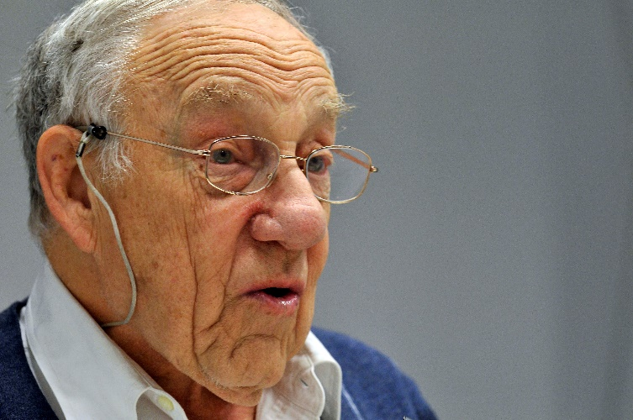
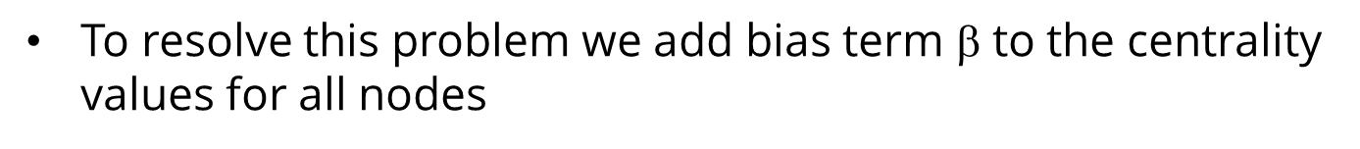
Katz Centrality
A major problem with eigenvector centrality arises when it deals with directed graphs
Centrality only passes over outgoing edges and in special cases such as when a node is in a directed acyclic graph centrality becomes zero
The node can have many edge connected to it
Elihu Katz
To resolve this problem we add bias term $$ to the centrality values for all nodes
Eigenvector Centrality

Slide 21
Katz Centrality, cont.
Controlling term
Bias term
Rewriting equation in a vector form
vector of all 1’s
Katz centrality:

Slide 22
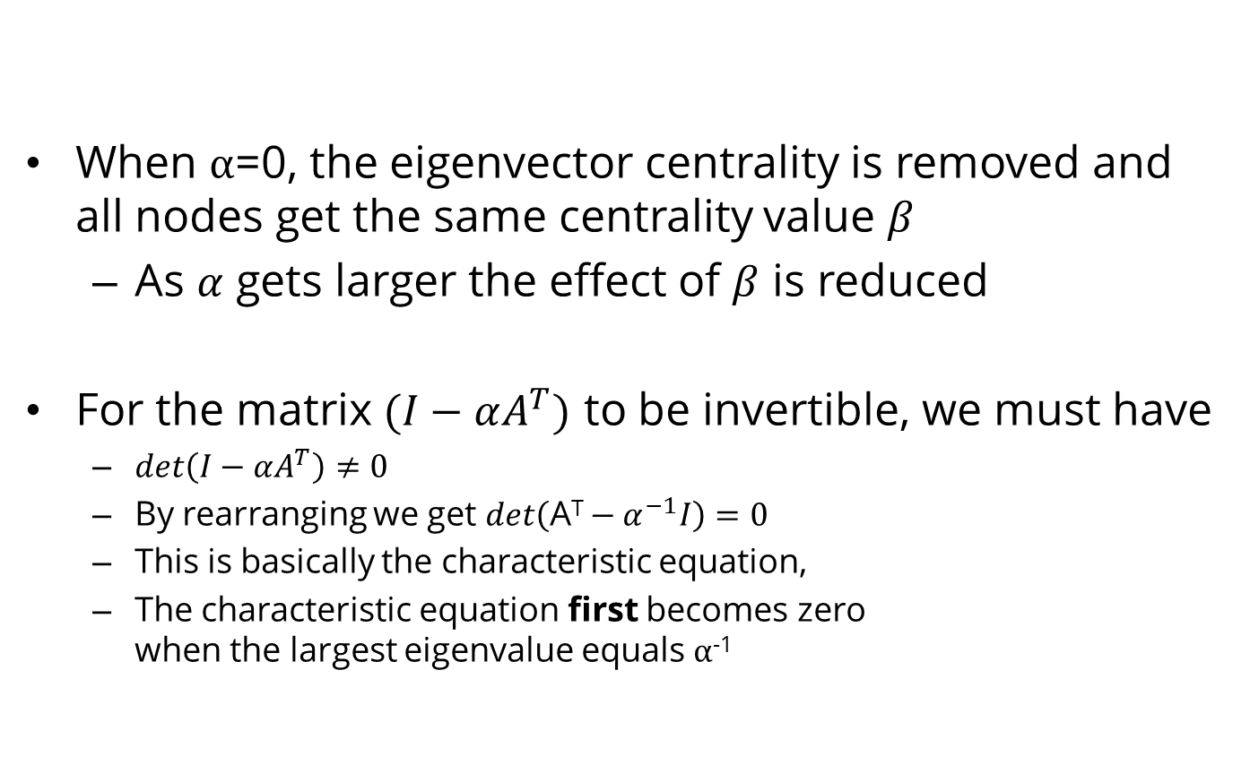
Katz Centrality, cont.
When $α$=0, the eigenvector centrality is removed and all nodes get the same centrality value $β$
As $α$ gets larger the effect of $β$ is reduced
For the matrix $(I−αA^{T})$ to be invertible, we must have
$det\left(I−αA^{T}\right)≠0$
By rearranging we get $det\left(\text{A}\text{T}−α^{−1}I\right)=0$
This is basically the characteristic equation,
The characteristic equation first becomes zero when the largest eigenvalue equals $α$⁻¹
The largest eigenvalue is easier to compute (power method)
In practice we select $α < 1/λ$, where $λ$is the largest eigenvalue of $AT$

Slide 23
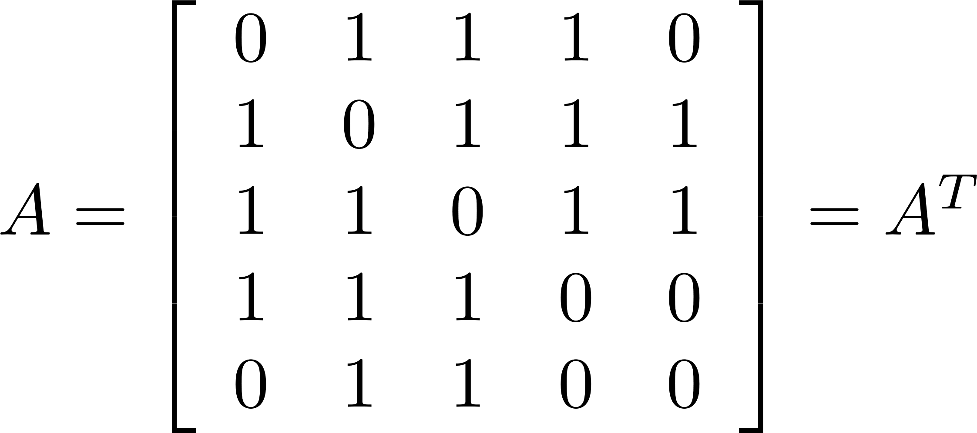
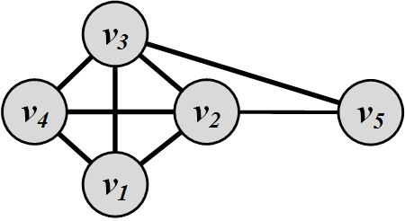
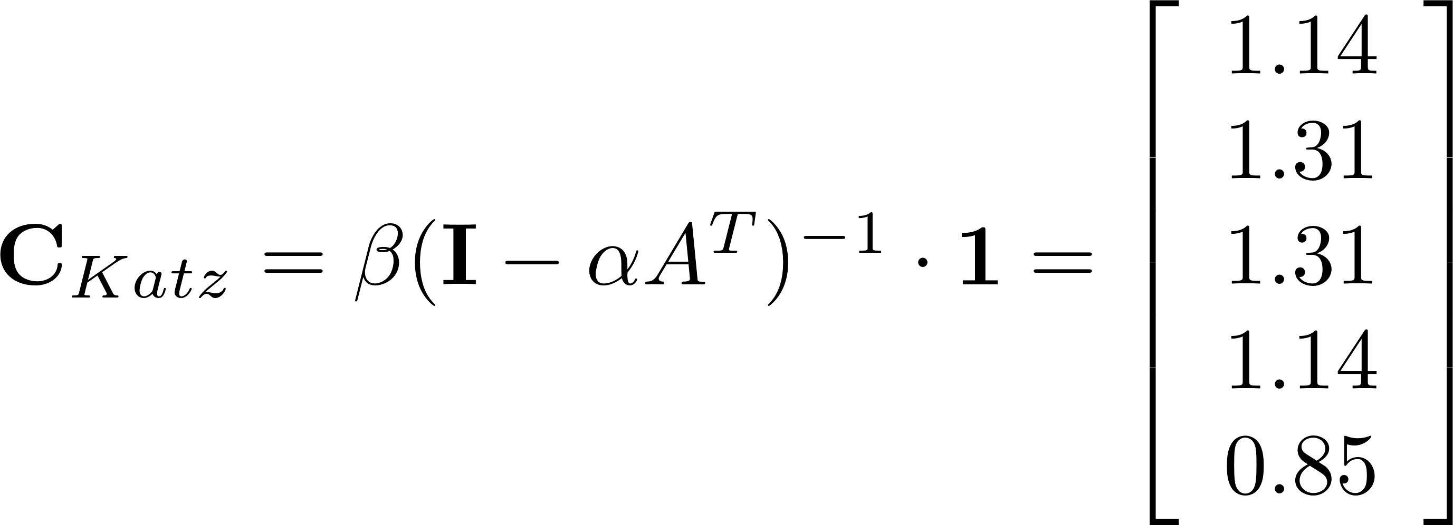
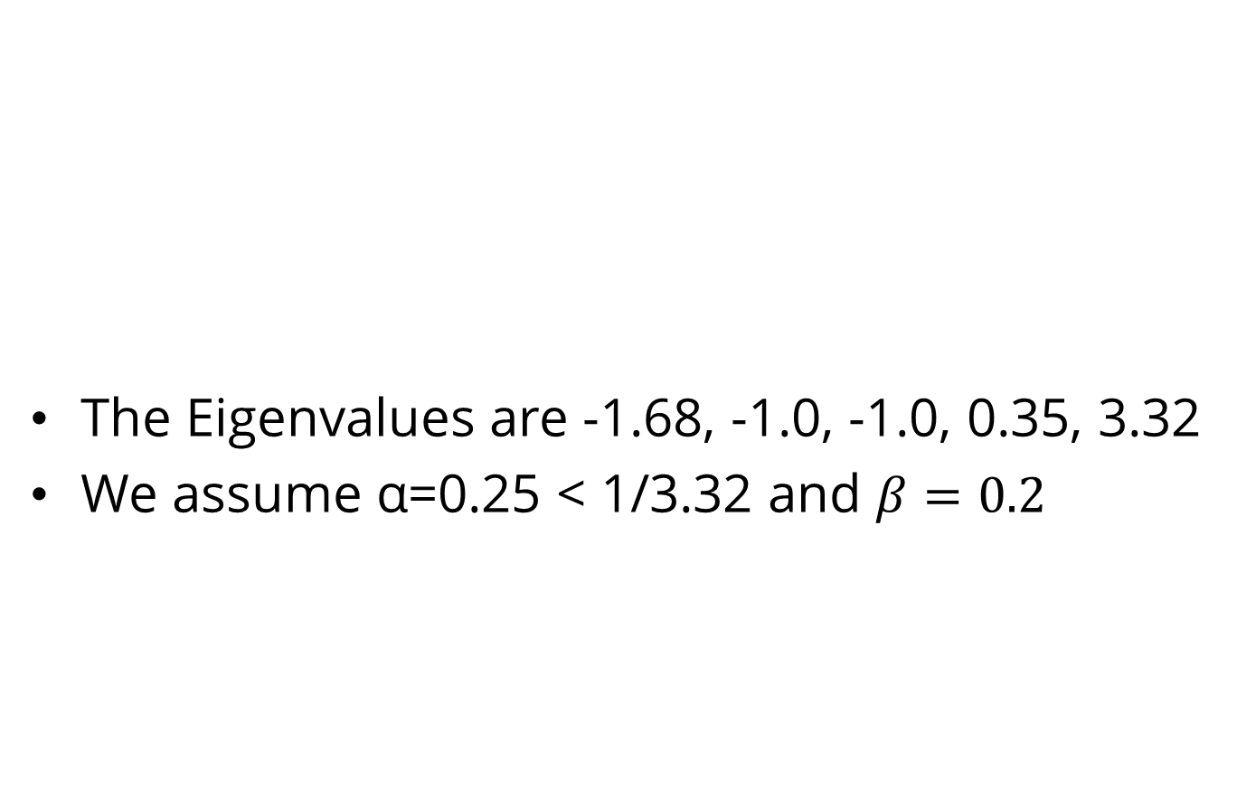
Katz Centrality Example
The Eigenvalues are -1.68, -1.0, -1.0, 0.35, 3.32
We assume α=0.25 < 1/3.32 and $β=0.2$
Most important
nodes!

Slide 24
PageRank
Problem with Katz Centrality:
In directed graphs, once a node becomes an authority (high centrality), it passes all its centrality along all of its out-links
This is less desirable since not everyone known by a well-known person is well-known
Solution?
We can divide the value of passed centrality by the number of outgoing links, i.e., out-degree of that node
Each connected neighbor gets a fraction of the source node’s centrality

Slide 25
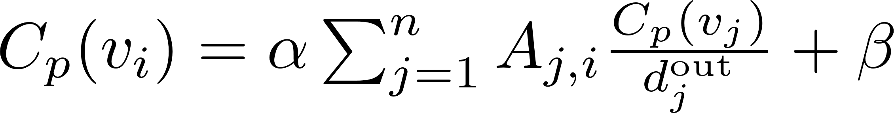
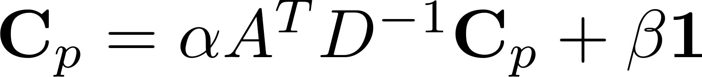
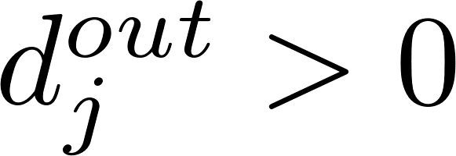
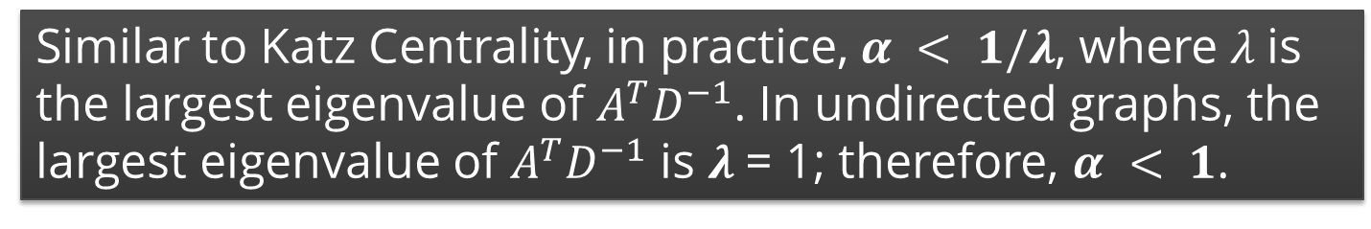
PageRank, cont.
What if the degree is zero?
Similar to Katz Centrality, in practice, $α < 1/λ$, where $λ$is the largest eigenvalue of $A^{T}D^{−1}$. In undirected graphs, the largest eigenvalue of $A^{T}D^{−1}$ is $λ$= 1; therefore, $α < 1$.

Slide 26
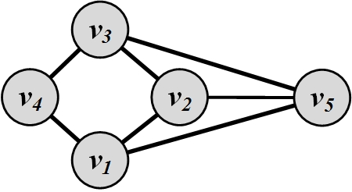
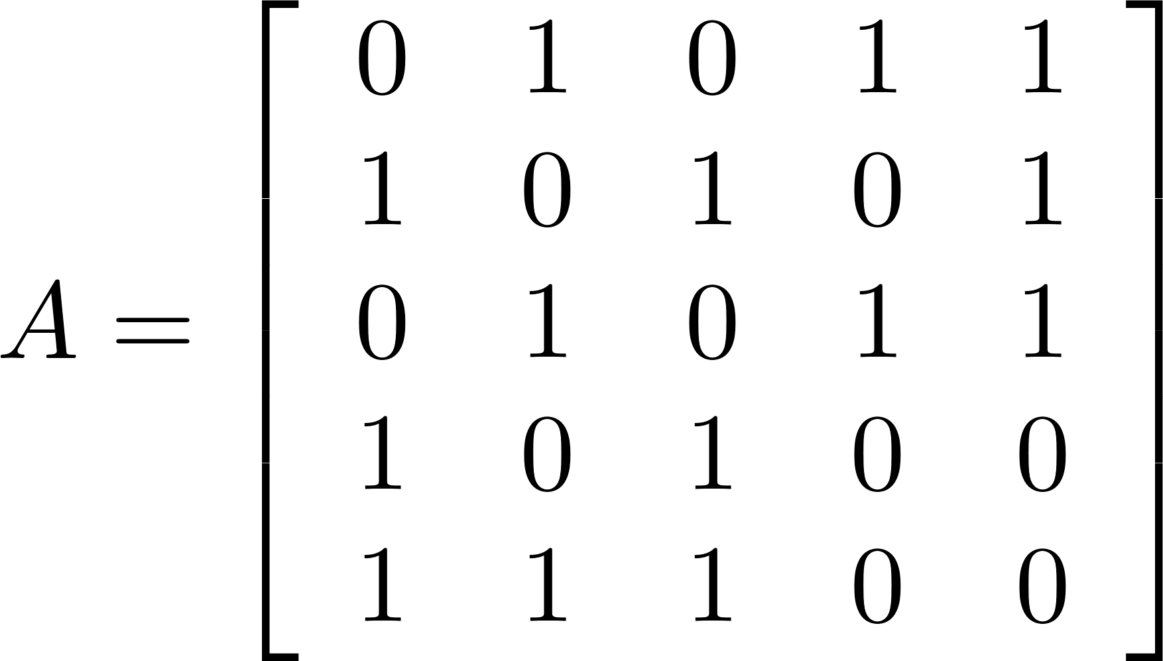
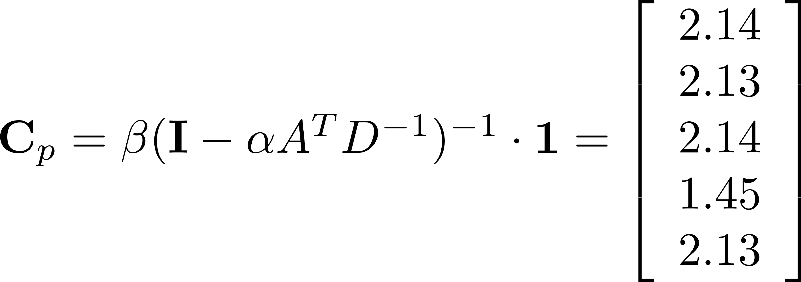

PageRank Example
We assume α=0.95 < 1 and and $β=0.1$

Slide 27



PageRank Example – Alternative Approach [Markov Chains]
”You don't understand anything until you learn it more than one way”
Using Power Method
Marvin Minsky (1927-2016)
$α\text{=1 }\text{and} β=$0?
Step | A | B | C | D | E | F | G
0 | 1/7 | 1/7 | 1/7 | 1/7 | 1/7 | 1/7 | 1/7
1 | B/2 | C/3 | A/3 + G | A/3 + C/3 + F/2 | A/3 + D | C/3 + B/2 | F/2 + E
 | 0.071 | 0.048 | 0.190 | 0.167 | 0.190 | 0.119 | 0.214
Notes:
Initial assignments are not important. In this example, \alpha = 1, \beta = 0
Normally, \alpha =0.85 and \beta = 0.15

Slide 28
PageRank: Example
Step | A | B | C | D | E | F | G | Sum
1 | 0.143 | 0.143 | 0.143 | 0.143 | 0.143 | 0.143 | 0.143 | 1.000
2 | 0.071 | 0.048 | 0.190 | 0.167 | 0.190 | 0.119 | 0.214 | 1.000
3 | 0.024 | 0.063 | 0.238 | 0.147 | 0.190 | 0.087 | 0.250 | 1.000
4 | 0.032 | 0.079 | 0.258 | 0.131 | 0.155 | 0.111 | 0.234 | 1.000
5 | 0.040 | 0.086 | 0.245 | 0.152 | 0.142 | 0.126 | 0.210 | 1.000
6 | 0.043 | 0.082 | 0.224 | 0.158 | 0.165 | 0.125 | 0.204 | 1.000
7 | 0.041 | 0.075 | 0.219 | 0.151 | 0.172 | 0.115 | 0.228 | 1.000
8 | 0.037 | 0.073 | 0.241 | 0.144 | 0.165 | 0.110 | 0.230 | 1.000
9 | 0.036 | 0.080 | 0.242 | 0.148 | 0.157 | 0.117 | 0.220 | 1.000
10 | 0.040 | 0.081 | 0.232 | 0.151 | 0.160 | 0.121 | 0.215 | 1.000
11 | 0.040 | 0.077 | 0.228 | 0.151 | 0.165 | 0.118 | 0.220 | 1.000
12 | 0.039 | 0.076 | 0.234 | 0.148 | 0.165 | 0.115 | 0.223 | 1.000
13 | 0.038 | 0.078 | 0.236 | 0.148 | 0.161 | 0.116 | 0.222 | 1.000
14 | 0.039 | 0.079 | 0.235 | 0.149 | 0.161 | 0.118 | 0.219 | 1.000
15 | 0.039 | 0.078 | 0.232 | 0.150 | 0.162 | 0.118 | 0.220 | 1.000
Rank | 7 | 6 | 1 | 4 | 3 | 5 | 2

Slide 29

Effect of PageRank
PageRank
Node | Rank
A | 7
B | 6
C | 1
D | 4
E | 3
F | 5
G | 2

Slide 30
Centrality in terms of how you connect others (information broker)

Slide 31






Betweenness Centrality
Another way of looking at centrality is by considering how important nodes are in connecting other nodes
Linton Freeman
The number of shortest paths from vertex $s$to $t$– a.k.a.
information pathways
The number of shortest paths from $s$to $t$that pass through $vi$

Slide 32



Normalizing Betweenness Centrality
In the best case, node $vi$ is on all shortest paths from $s$ to $t$, hence,
Therefore, the maximum value is $(n−1)(n−2)$
Betweenness centrality:

Slide 33


Betweenness Centrality: Example 1

Slide 34

Betweenness Centrality: Example 2
Node | Betweenness Centrality | Rank
A | 16 + 1/2 + 1/2 | 1
B | 7+5/2 | 3
C | 0 | 7
D | 5/2 | 5
E | 1/2 + 1/2 | 6
F | 15 + 2 | 1
G | 0 | 7
H | 0 | 7
I | 7 | 4

Slide 35

Computing Betweenness
In betweenness centrality, we compute shortest paths between all pairs of nodes to compute the betweenness value.
Trivial Solution:
Use Dijkstra and run it $O(n)$times
We get an ${O(n}^{3})$ solution
Better Solution:
Brandes Algorithm:
$O(nm)$for unweighted graphs
$O(nm+n^{2}\log{n})$for weighted graphs

Slide 36



Brandes Algorithm [2001]
There exists a recurrence equation that can help us determine $δ_{s}(v_{i})$
$pred(s,w)$ is the set of predecessors of $w$in the shortest paths from $s$to $w$.
In the most basic scenario, $w$ is the immediate child of $v_{i}$

Slide 37

How to compute $σ_{st}$
Original Network
Sum of Parents values
BFS starting at A (i.e., $s$)
Source: Networks, Crowds, and Markets: Reasoning about a Highly Connected World. By David Easley and Jon Kleinberg

Slide 38


How do you compute $δ_{s}(v_{i})$
1/1(3/2+1)+1/1(3/2+1)
2/2 (1+0)
No shortest path starting from 1 passes through 9

Slide 39
Centrality in terms of how fast you can reach others

Slide 40


Closeness Centrality
The intuition is that influential/central nodes can quickly reach other nodes
These nodes should have a smaller average shortest path length to others
Linton Freeman
Closeness centrality:

Slide 41

Closeness Centrality: Example 1

Slide 42
Closeness Centrality: Example 2 (Undirected)
Node | A | B | C | D | E | F | G | H | I | D_Avg | Closeness Centrality | Rank
A | 0 | 1 | 2 | 1 | 2 | 1 | 2 | 3 | 2 | 1.750 | 0.571 | 1
B | 1 | 0 | 1 | 2 | 1 | 2 | 3 | 4 | 3 | 2.125 | 0.471 | 3
C | 2 | 1 | 0 | 3 | 2 | 3 | 4 | 5 | 4 | 3.000 | 0.333 | 8
D | 1 | 2 | 3 | 0 | 1 | 2 | 3 | 4 | 3 | 2.375 | 0.421 | 4
E | 2 | 1 | 2 | 1 | 0 | 3 | 4 | 5 | 4 | 2.750 | 0.364 | 7
F | 1 | 2 | 3 | 2 | 3 | 0 | 1 | 2 | 1 | 1.875 | 0.533 | 2
G | 2 | 3 | 4 | 3 | 4 | 1 | 0 | 3 | 2 | 2.750 | 0.364 | 7
H | 3 | 4 | 5 | 4 | 5 | 2 | 3 | 0 | 1 | 3.375 | 0.296 | 9
I | 2 | 3 | 4 | 3 | 4 | 1 | 2 | 1 | 0 | 2.500 | 0.400 | 5

Slide 43

Closeness Centrality: Example 3 (Directed)
Node | A | B | C | D | E | F | G | H | I | D_Avg | Closeness Centrality | Rank
A | 0 | 1 | 2 | 3 | 2 | 2 | 1 | 3 | 3 | 2.125 | 0.471 | 1
B | 3 | 0 | 1 | 2 | 1 | 4 | 4 | 2 | 3 | 2.500 | 0.400 | 2
C | 4 | 5 | 0 | 7 | 6 | 3 | 5 | 1 | 2 | 4.125 | 0.242 | 9
D | 1 | 2 | 3 | 0 | 3 | 3 | 2 | 4 | 5 | 2.875 | 0.348 | 3
E | 2 | 3 | 4 | 1 | 0 | 4 | 3 | 5 | 5 | 3.375 | 0.296 | 6
F | 1 | 2 | 3 | 4 | 3 | 0 | 2 | 4 | 4 | 2.875 | 0.348 | 4
G | 2 | 3 | 4 | 5 | 4 | 1 | 0 | 5 | 2 | 3.250 | 0.308 | 5
H | 4 | 4 | 5 | 6 | 5 | 2 | 4 | 0 | 1 | 3.875 | 0.258 | 8
I | 2 | 3 | 4 | 5 | 4 | 1 | 4 | 5 | 0 | 3.500 | 0.286 | 7

Slide 44
An Interesting Comparison!
Comparing three centrality values
Generally, the 3 centrality types will be positively correlated
When they are not (or low correlation), it usually reveals interesting information
Low
Degree
Low
Closeness
Low
Betweenness
High
Degree
Node is embedded in a community that is far from the rest of the network
Ego's connections are redundant - communication bypasses the node
High
Closeness
Probably multiple paths in the network, ego is near many people, but so are many others
Key node connected to important/active alters
High
Betweenness
Ego's few ties are crucial for network flow
Very rare! Ego monopolizes the ties from a small number of people to many others.
This slide is modified from a slide developed by James Moody

Slide 45
Centrality for a group of nodes

Slide 46

Group Centrality
All centrality measures defined so far measure centrality for a single node. These measures can be generalized for a group of nodes.
A simple approach is to replace all nodes in a group with a super node
The group structure is disregarded.
Let $S$ denote the set of nodes in the group and $V−S$ the set of outsiders

Slide 47



Group Centrality
I. Group Degree Centrality
Normalization:
II. Group Betweenness Centrality
Normalization:
divide by $|V−S|$
divide by

Slide 48



Group Centrality
III. Group Closeness Centrality
It is the average distance from non-members to the group
One can also utilize the maximum distance or the average distance

Slide 49


Group Centrality Example
Consider $S=\{v_{2},v_{3}\}$
Group degree centrality =
Group betweenness centrality =
Group closeness centrality =
3
3
1

Slide 50
Friendship Patterns
Transitivity/Reciprocity
Status/Balance

Slide 51
I. Transitivity and Reciprocity

Slide 52



Transitivity
Mathematic representation:
For a transitive relation $R$:
In a social network:
Transitivity is when a friend of my friend is my friend
Transitivity in a social network leads to a denser graph, which in turn is closer to a complete graph
We can determine how close graphs are to the complete graph by measuring transitivity
$cRa$or $aRc$?

Slide 53


[Global] Clustering Coefficient
Clustering coefficient measures transitivity in undirected graphs
Count paths of length two and check whether the third edge exists
When counting triangles, since every triangle has 6 closed paths of length 2

Slide 54



Clustering Coefficient and Triples
Or we can rewrite it as
Triple: an ordered set of three nodes,
connected by two (open triple) edges or
three edges (closed triple)
A triangle can miss any of its three edges
A triangle has 3 Triples
$v_{i}v_{j}v_{k}$ and $v_{j}v_{k}v_{i}$are different triples
The same members
First missing edge ${{e(v}_{k},v}_{i})$ and second missing ${{e(v}_{i},v}_{j})$
$v_{i}v_{j}v_{k}$and $v_{k}v_{j}v_{i}$are the same triple

Slide 55


[Global] Clustering Coefficient: Example

Slide 56



Local Clustering Coefficient
Local clustering coefficient measures transitivity at the node level
Commonly employed for undirected graphs
Computes how strongly neighbors of a node $v$ (nodes adjacent to $v$) are themselves connected
In an undirected graph, the denominator can be rewritten as:
Provides a way to determine
structural holes
Structural
Holes

Slide 57


Local Clustering Coefficient: Example
Thin lines depict connections to neighbors
Dashed lines are the missing link among neighbors
Solid lines indicate connected neighbors
When none of neighbors are connected $C=0$
When all neighbors are connected $C=1$

Slide 58




Reciprocity
If you become my friend, I’ll be yours
Reciprocity is simplified version of transitivity
It considers closed loops of length 2
If node $v$ is connected to node $u$,
$u$by connecting to $v$, exhibits reciprocity
What about $i=j$ ?

Slide 59



Reciprocity: Example
Reciprocal nodes: $v1, v2$

Slide 60


II. Balance and Status
Measuring consistency in friendships

Slide 61



Social Balance Theory
Social balance theory
Consistency in friend/foe relationships among individuals
Informally, friend/foe relationships are consistent when
In the network
Positive edges demonstrate friendships ($wij=1$)
Negative edges demonstrate being enemies ($wij=−1$)
Triangle of nodes $i, j$, and $k$, is balanced, if and only if
$wij$ denotes the value of the edge between nodes $i$ and$j$

Slide 62

Social Balance Theory: Possible Combinations
For any cycle, if the multiplication of edge values become positive, then the cycle is socially balanced

Slide 63
Social Status Theory
Status: how prestigious an individual is ranked within a society
Social status theory:
How consistent individuals are in assigning status to their neighbors
Informally,

Slide 64


Social Status Theory: Example
Unstable configuration
Stable configuration
A directed ‘+’ edge from node $X$ to node $Y$ shows that $Y$ has a higher status than $X$ and a ‘-’ one shows vice versa

Slide 65
Similarity
How similar are two nodes in a network?
Structural Equivalence
Regular Equivalence

Slide 66
Structural Equivalence
Structural Equivalence:
We look at the neighborhood shared by two nodes;
The size of this shared neighborhood defines how similar two nodes are.
Example:
Two brothers have in common
sisters, mother, father, grandparents, etc.
This shows that they are similar,
Two random male or female individuals do not have much in common and are dissimilar.

Slide 67



Structural Equivalence: Definitions
Vertex similarity:
The neighborhood $N(v)$ often excludes the node itself $v$.
What can go wrong?
Connected nodes not sharing a neighbor will be assigned zero similarity
Solution:
We can assume nodes are included in their neighborhoods
Normalize?
Jaccard Similarity:
Cosine Similarity:

Slide 68

Similarity: Example

Slide 69

Similarity Significance
Measuring Similarity Significance: compare the calculated similarity value with its expected value where vertices pick their neighbors at random
For vertices $v_{i}$ and $v_{j}$ with degrees $di$ and $dj$ this expectation is $didj/n$
There is a $di/n$ chance of becoming $v_{i}$‘s neighbor
$v_{j}$ selects $dj$ neighbors
We can rewrite neighborhood overlap as

Slide 70


Normalized Similarity, cont.
What is this?

Slide 71



Normalized Similarity, cont.
$n$ times the Covariance between $Ai$ and $Aj$
Normalize covariance by the multiplication of Variances.
We get Pearson correlation coefficient
(range of σ ∈ [-1,1] )

Slide 72


Regular Equivalence
In regular equivalence,
We do not look at neighborhoods shared between individuals, but
How neighborhoods themselves are similar
Example:
Athletes are similar not because they know each other in person, but since they know similar individuals, such as coaches, trainers, other players, etc.

Slide 73



Regular Equivalence
$vi$, $vj$ are similar when their neighbors $vk$and $vl$ are similar
The equation (left figure) is hard to solve since it is self referential so we relax our definition using the right figure

Slide 74






Regular Equivalence
$vi$ and $vj$ are similar when $vj$ is similar to $vi$’s neighbors $vk$
In vector format
A vertex is highly similar to itself, we guarantee this by adding an identity matrix to the equation
W$hen α<1/λ_{max}$ the matrix is invertible

Slide 75




Regular Equivalence: Example
The largest eigenvalue of $A$ is 2.43
Set $α = 0.3 < 1/2.43$
Any row/column of this matrix shows the similarity to other vertices
Vertex 1 is most similar (other than itself) to vertices 2 and 3
Nodes 2 and 3 have the highest similarity (regular equivalence)

